Slide 1
Important information
Unifrog’s Placements tool is a work experience admin management tool. It helps with getting all the necessary information and agreements for work experience to take place.
The tool also includes a searchable database of placement contacts, to help schools and colleges source placements for students.
Students should only log a placement in the Placements tool after they have agreed a placement with an employer.
See the final slide of this presentation for helpful Unifrog resources around Work Experience placements!

Slide 2

Unifrog and the Placements tool

Slide 3

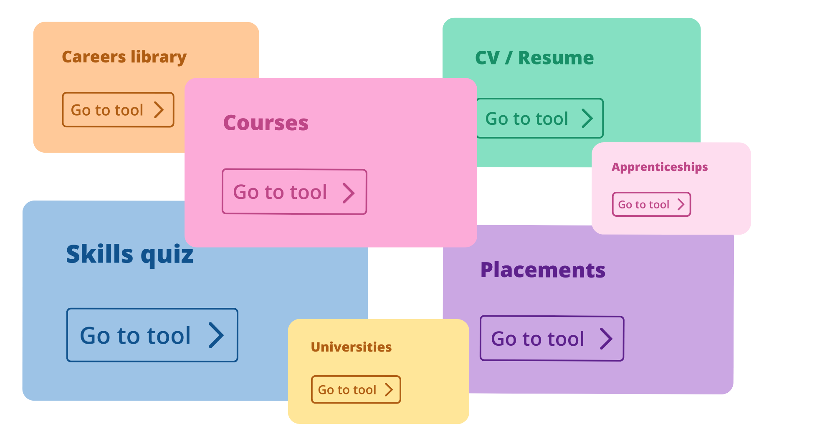
What is Unifrog?
Unifrog is an online careers platform used by over half of the secondary schools and colleges in the UK. The platform has various tools to help students research careers and future pathways,
draft CVs and personal statements,
and manage work experience.
2 min overview of Unifrog as a whole

Slide 4

Using the Unifrog Placements tool
Unifrog’s Placements tool helps schools, students, parents
and employers with the admin behind work experience.
More than 1900 schools use this tool to organise
work experience, and 345,000+ placements have
been processed through the tool!
2 min overview of the Placements tool

Slide 5

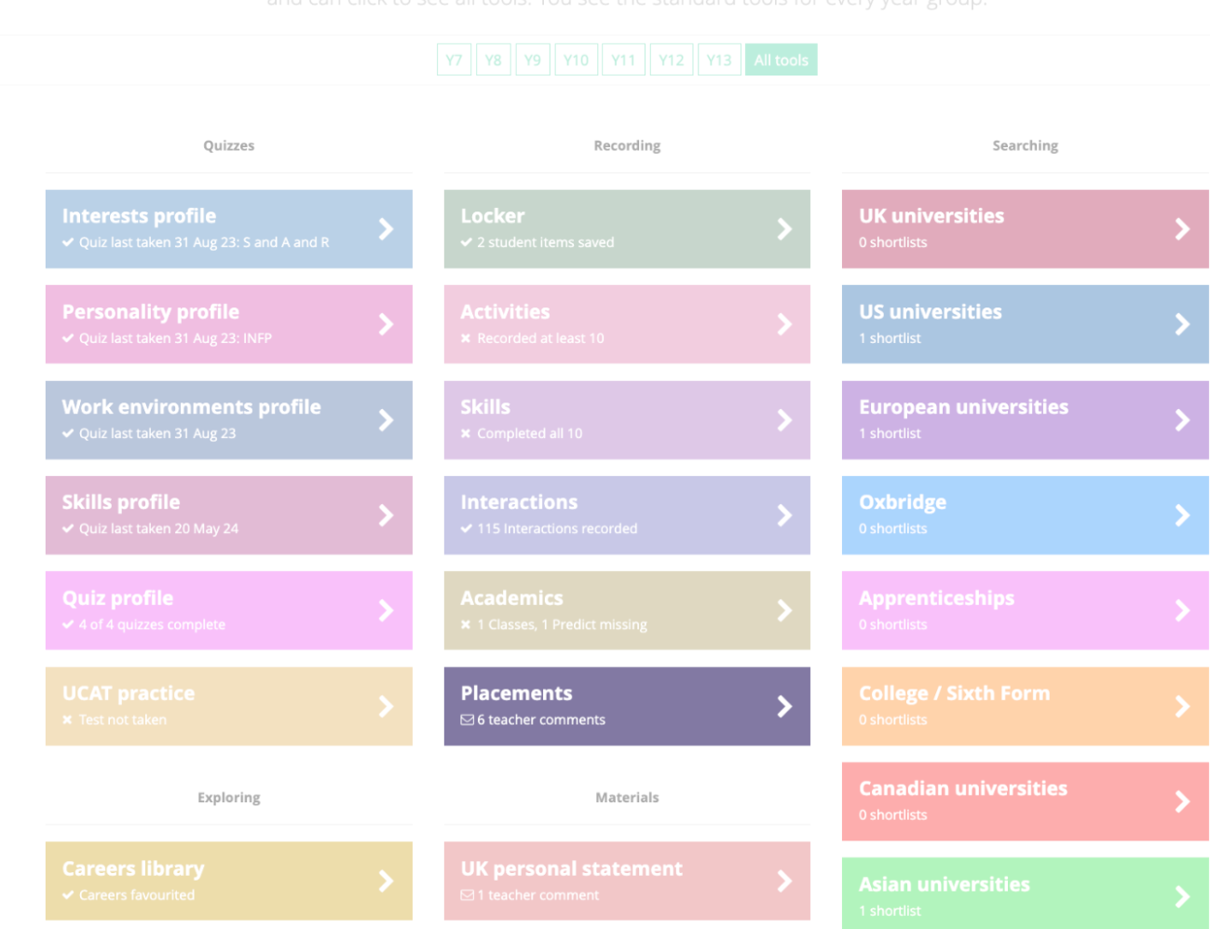
Using the Unifrog Placements tool
After the student has agreed a placement with an employer,
they need to log into their Unifrog account to log the Placement.
This starts off a chain of forms.
After the student completes the first form:
The system emails the employer to complete their form
The parent/guardian form comes next
The school/college completes their permission form
Here’s what parents/guardians need to know about placements forms.

Slide 6

Next steps
Students
Agree a placement with an employer.
Log the information on the Unifrog placements tool.
Parents/caregivers
Support your child to source a placement. Encourage them to log it on Unifrog.
Look out for an email from Unifrog once the student and the employer have
completed their forms.

Slide 7

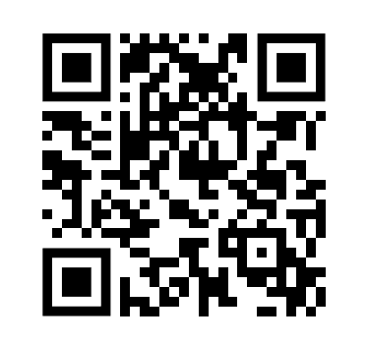



More info
Unifrog have created a set of guides about placements here.
This is the best guide to start with
(it includes a short animation of how the whole process works).
Next, we recommend looking at this guide
(it’s all about how to help your child to find a placement).
Scan the QR to
see all guides
Pro tip: check out the apprenticeships tool on Unifrog to research local employers who may be open to hosting a placement.

